Slide 1

Comparing the Accuracy of Text Classification Using Multiple Stemming and Explainable AI Lime, Eli5
Group: 16
ID: 23266024 || Mithila Arman
ST: Mehnaz Ara Fazal
RA: Md Humaion Kabir Mehedi

Slide 2
Introduction
Motivation
Relevance
Mission
Outline
Background Study
Literature Review
20 Newsgroups Dataset
Methodology
Results And Anslysis
Future work
Conclusion

Slide 3
Introduction
The efficient classification of textual data is an important challenge in the era of information explosion, with extensive applications spanning from document classification to sentiment analysis. The preprocessing of textual data is necessary for text classification models to work well, and stemming is one important way to improve feature representation.

Slide 4
Motivation
Efficient Text Classification
Preprocessing Impact
Classifier Evaluation
Feature Reduction with PCA
Exploitability in AI
Insights into Stemming Techniques

Slide 5
Relevance of Text Classification
Information Organization | Document Categorization
Sentiment Analysis | Filtering and Prioritization
Personalization in Recommender Systems | Security and Spam Detection
Customer Support Automation | News Aggregation
Medical Diagnosis | Legal Document Classification

Slide 6
Mission
Research Exploration
Classifier Performance Evaluation
Dimensionality Reduction Techniques
Explainable AI Integration

Slide 7
Background Study
Text Classification Techniques
Preprocessing in Text Classification
Role of Stemming
Classifier Selection
Dimensionality Reduction with PCA
Explainable AI (XAI)

Slide 8
Literature Review
Name | Method they used | Dataset | Result
Text Classification Techniques | Naive Bayes, Support Vector Machines, Deep Learning | Reuters-21578 | text classification techniques, highlights the strengths and weaknesses of different approaches.
Stemming Algorithms | Porter Stemmer | MEDLINE dataset | superior performance in terms of accuracy
Classifier Performance in Text Classification | Naive Bayes, Support Vector Machines and Logistic Regression | Reuters-21578 | Support Vector Machine classifier achieves the best accuracy
Dimensionality Reduction Techniques | Principal Component Analysis (PCA) for dimensionality reduction | 20 Newsgroups dataset | PCA significantly reduces the dimensionality of the feature space

Slide 9
Literature Review
Paper Name | Method they used | Dataset | Result
Explainable AI (XAI) in Text Classification | LIME and SHAP | 20 Newsgroups dataset | XAI techniques can provide insights into the decision-making process of black-box models.
Comparison of Stemming Strategies Across Classifiers | Porter and Snowball stemming | Reuters-21578 | Porter stemming generally performing slightly better than Snowball stemming

Slide 10
20 Newsgroups dataset
The 20 Newsgroups dataset consists of approximately 20,000 documents spanning 20 different newsgroups, offering a diverse range of topics.
Documents in the dataset are primarily textual, associated with specific categories or newsgroups covering a broad array of subjects.

Slide 11
Methodology
Data Preprocessing
Text Cleaning
Tokenization and Part-of-Speech Tagging
Stemming and Stopword Removal
TF-IDF Feature Extraction and PCA
TF-IDF Feature Extraction
Principal Component Analysis (PCA)
Classifier Training and Evaluation
Classifier Selection
Training and Testing
Metrics Evaluation
Explainable AI (XAI) Integration
Lime and Eli5
Visualization

Slide 12
RESULT AND ANALYSIS
Naive Bayes achieved the highest accuracy (64.22%) with Snowball stemming and part-of-speech tagging. Support Vector Machines showed variable performance with different stemmers, and tree-based classifiers favored Porter stemming.
Lime provided local interpretable explanations for Naive Bayes predictions, enhancing transparency. Eli5 ranked features and weights, improving comprehension of XGBoost's decision-making.

Slide 13
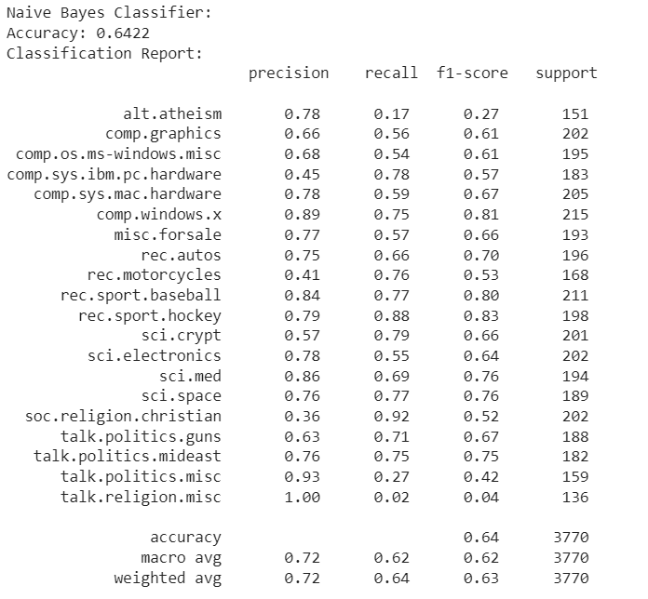
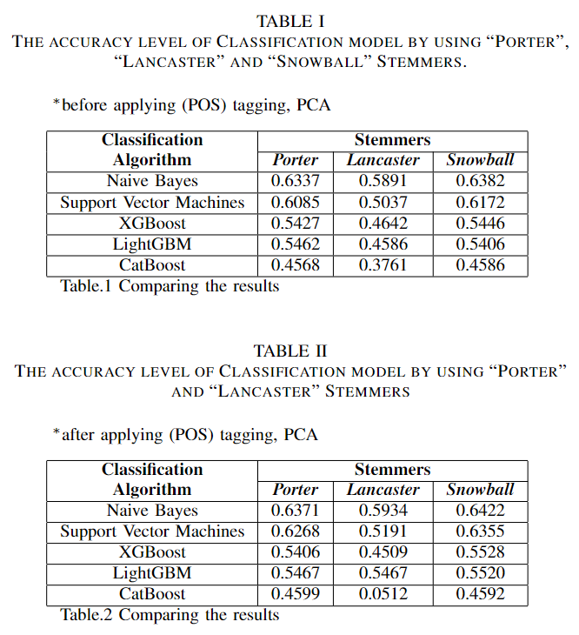
RESULT AND ANALYSIS

Slide 14
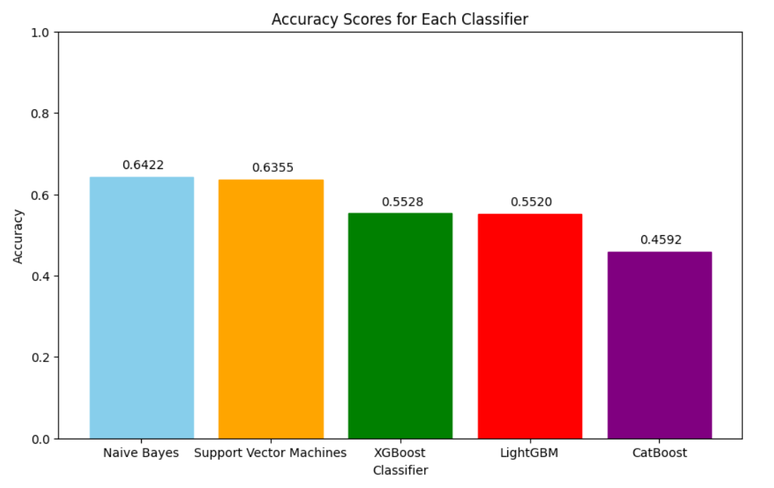
Bar Plot of Accuracy Scores

Slide 15
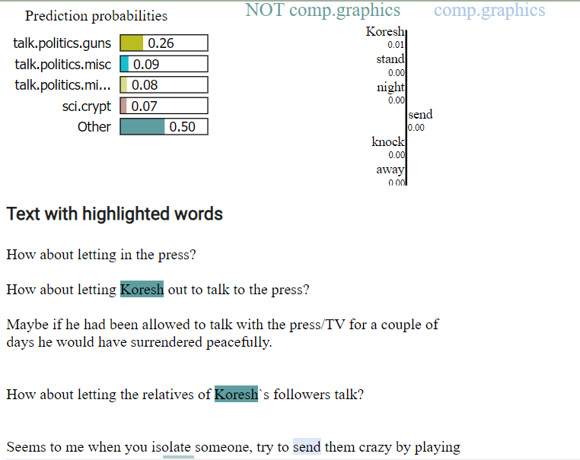
Explainable AI Lime

Slide 16
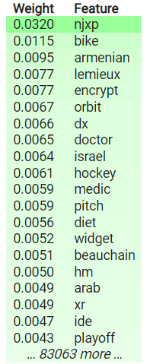
Explainable AI Eli5

Slide 17
Future work
Advanced Preprocessing Techniques
Synergies with Deep Learning
Domain-specific Tailoring
Enhanced Model Explainability

Slide 18
Conclusions
Snowball and Porter stemming demonstrated superior performance
Lime and Eli5 enhanced model transparency
Will focus on advanced preprocessing techniques, exploring synergies with deep learning, domain-specific tailoring of stemming algorithms, and addressing ethical considerations for unbiased and responsible text classification models.

